Slide 1

node.js
Takeaways from 2016 Node Summit

Slide 2

what is node summit?
Largest event focused on node.
Companies and individuals working with node and the node.js community.
Some of the companies Present:
Nasa
Google
Disney
Walmart Labs
Paypal
IBM

Slide 3








Node.JS in the Wild

Slide 4
what is node.js?
Cross-Platform runtime environment for fast, scalable network applications. Not exactly a javascript framework.
Built on Google V8 Javascript engine
Written in C++
Event Driven - Single Process
Asynchronous, Non Blocking I/O
For fast & scalable network Applications

Slide 5
WHY Node.js?
data-intensive real-time applications
real time, two-way connections. Traditional HTTP is stateless.
light weight and efficient

Slide 6
Overall Structure
API in written in Javascript. directly exposs Node.js internal workings
Node bindings - Core API which bind Javascript with C/C++ libraries
You can develop your own Node.js add-ons using C/C++ to work with Node.js
Relies on Google’s V8 runtime engine
Libuv responsible for handling thread pool, async I/O and event loop
Node.js API
JS
Node.js Bindings (Socket, http, etc)
C/C++ Add-ons
JS / C++
V8
Libuv
(Thread pool, Event loop, Async I/O)
C-ares
(Async DNS)
Http_Parser, OpenSSL, zlib, etc.
C++

Slide 7
V8 Runtime engine
Just-in-Time compiler, written in C++
Consists of compiler, optimizer, and garbage collector
Compiles code into native machine code, instead of interpretation
Fastest compiler for Javascript

Slide 8
node.js (good use cases)
Rest + JSON APIs
well suited for applications that have a lot of concurrent connections and each request only needs very few CPU cycles.
Perfect for handling lots of small requests that might be I/O intensive or require connections to external resources such as databases
Real-Time Applications; instances where you want to maintain a persistent connection between server and client. i.e long polling technique
Streaming Applications; File Uploads, Simple proxies.
Microservices

Slide 9
Node.js (Bad Use Cases)
CPU Intensive applications / Jobs
Mathematical computations.
Applications needing to process large amounts of data in parallel, unless using worker processes

Slide 10
node.js at webmd
Node vs Java; it’s not a case of which is better. depends on the use case.
Node.js uses a single threaded event-driven paradigm.
fast when handling plenty of concurrent requests at once, compared to traditional multi-threaded Java or ROR frameworks that spurn multiple threads.
suitable for rapid prototyping.

Slide 11
Examples
Request Models (with 2 requests: r1, r2);
Waiting Way: serves one request and wait for response before serving next request
Threading Way: one thread per request. fast but memory intensive.
Node Way: each request registers a callback with the event loop. callback is executed when event is triggered. no waiting, no threading, no memory consumption. it’s most efficient.

Slide 12
limitations
Single point of failure for all requests.
one long-running blocking operation can hold up the event loop.

Slide 13
Node.js is thread based (encapsulated in libuv).
external modules using native c++ and libuv are likely to use the thread pool. i.e database access, file system access.
default thread pool size is 4. Any other long running async task gets queued.
not all asynchronous operations are performed through the thread pool.

Slide 14
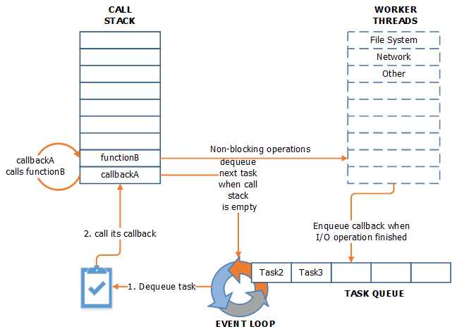
workflow

Slide 15
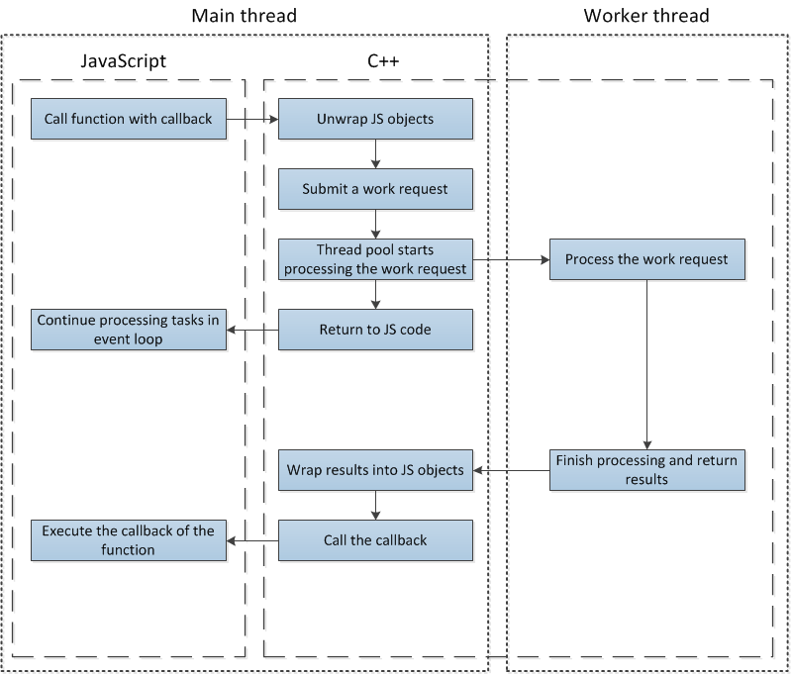
under the hood
simplified diagram of execution flow for a task using the thread pool.

Slide 16
v8 engine
optimizes Javascript and compiles to C++ code. (convert datatypes to c++ equivalents).
not thread-safe

Slide 17
use case 1:
database-heavy application
node thread pool size = 4
database with connection pool = 10 (can accept up to 10 queries in parallel)

Slide 18
use case 2:
database-heavy application
node thread pool size = 4
Slow database with connection pool = 10.
Thread pool is used up
subsequent Async tasks stuck in the request queue behind database queries
App slows down

Slide 19
solution
increase node thread pool: process.env.UV_THREADPOOL_SIZE = n;
lower size of database connection pool.

Slide 20
sample code
var fs = require(‘fs');
process.env.UV_THREADPOOL_SIZE = 10; // This will work
// First time thread pool is required
fs.readdir('.', function () {
process.env.UV_THREADPOOL_SIZE = 20; // This won’t
….
});

Slide 21
Future of node.js
Improved scalability
Security - Improved spec-compliance around HTTP which has been a major source of security issues.
exploration of threaded workloads
Node v5 is EOL. Move on to version 6.
support of promise usage within core Node.js
low-level javascript features: Tail calls
language enhancement proposals.
Deprivation of domains ( widely considered a failure)
HTTP/2

Slide 22
v8 optimizations
Javascript is loosely typed. No classes.
properties can be added to objects on the fly.
Dictionary for dynamic lookup (most javascript engines) vs hidden classes (V8).
Hidden classes for internal representation of the type system and to improve the property access time.

Slide 23
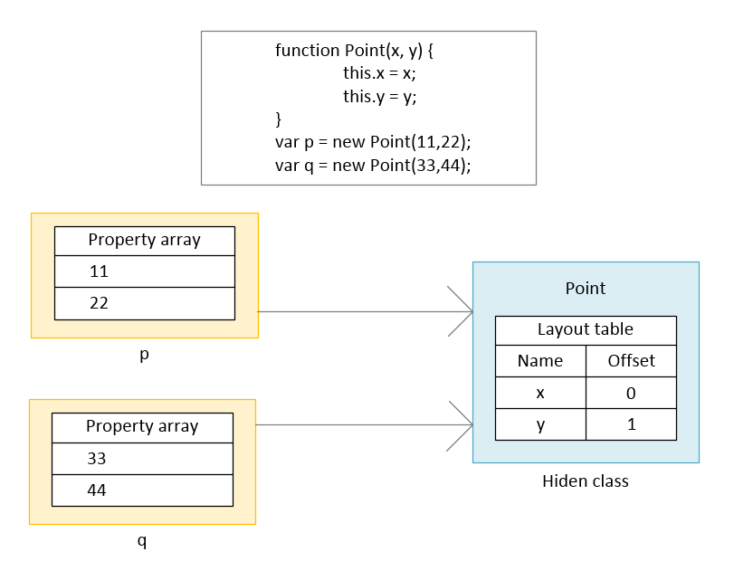
v8 optimizations

Slide 24
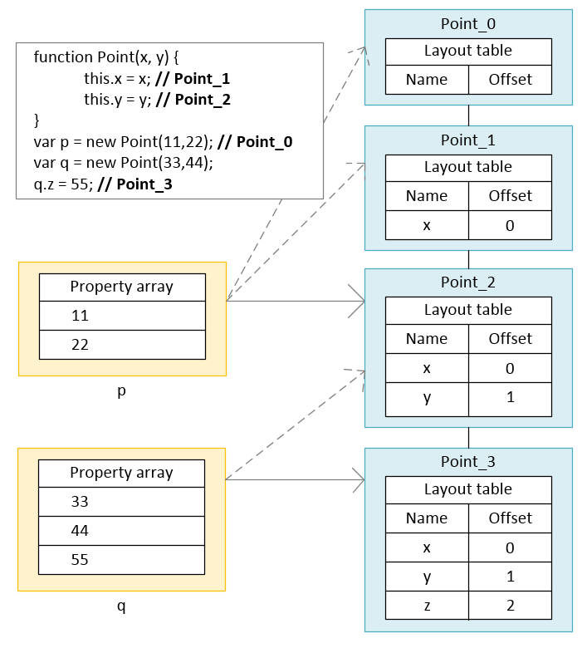
v8 optimizations

Slide 25
solution
Keep hidden classes to a minimum.
avoid adding properties after object creation if possible
call functions with same parameter types to avoid creation of hidden class.
prefer monomorphic code to polymorphic.
arrays vs dictionary elements (js dict is actually a hash table. access is expensive)
don’t pre-allocate large arrays.
don’t delete elements inside an array.

